Slide 1
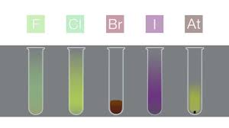
CHEMICAL PROPERTIES OF HALOGEN

Slide 3
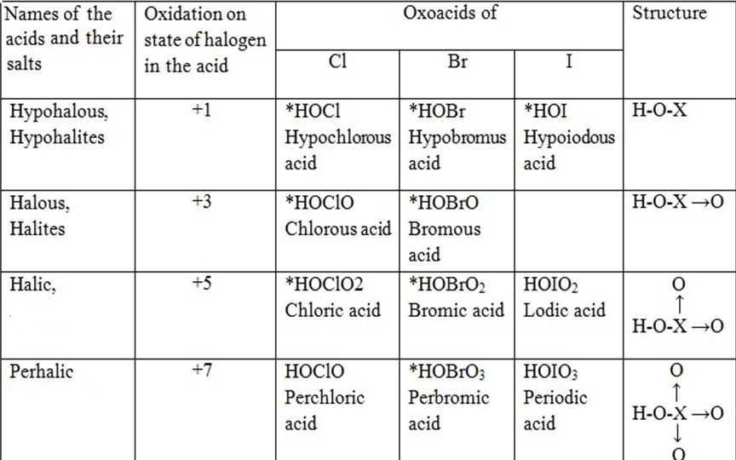

Slide 4
INTERHALOGEN COMPOUNDS

Slide 7
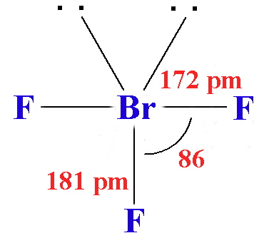
STRUCTURE OF BrF3

Slide 8
REACTIVITY OF INTERHALOGEN COMPOUNDS
The inter halogens are generally more reactive than halogens except F. This is because A-X bonds in interhalogens are weaker than the X-X bonds in dihalogen molecules. Reaction of inter halogens are similar to halogens. Hydrolysis of interhalogen compounds give halogen acid and oxy-acid.

Slide 9
USES OF INTERHALOGENS
Some interhalogens, such as BrF₃, IF₅, and ICl, are good halogenating agents. BrF₅ is too reactive to generate fluorine. Beyond that, iodine monochloride has several applications, including helping to measure the saturation of fats and oils, and as a catalyst for some reactions. A number of interhalogens, including IF₇, are used to form polyhalides.

